Slide 1
Figure 9-1: A sample Ethernet configuration
File Server
Workstation
Workstation
Bridge
1
3
5
7
2
4
6
PC
PC
Printer
26年 11月 8日
Copyright © 1997 Oxford University Press
All Rights Reserved

Slide 2
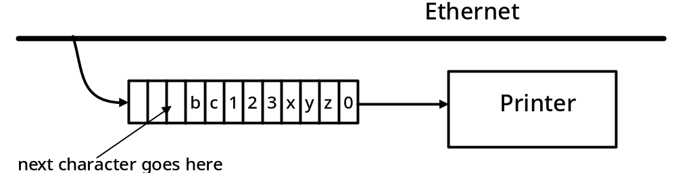
Figure 9-2: Operation of a buffer on an Ethernet
26年 11月 8日
Copyright © 1997 Oxford University Press
All Rights Reserved

Slide 3
ADT 9-1
Characteristics
• A Queue Q stores items of some type (queueElementType), with First-In, First-Out (FIFO) access.
Operations
queueElementType A.dequeue()
Precondition: !isEmpty()
Postcondition: Q_{post} = Q_{pre} with front removed
Returns: The least-recently enqueued item (the front).
26年 11月 8日
Copyright © 1997 Oxford University Press
All Rights Reserved

Slide 4
ADT 9-1
void Q.enqueue(queueElementType x)
Precondition: None
Postcondition: Qpost = Qpre with item x added to the rear.
queueElementType Q.front()
Precondition: !isEmpty()
Postcondition: None
Returns: The least-recently enqueue item (the front).
bool Q.isEmpty()
Precondition: None
Postcondition: None
Returns: true if and only if Q is empty, I.e., contains no data items.
26年 11月 8日
Copyright © 1997 Oxford University Press
All Rights Reserved

Slide 5
Code Example 9-1
// cx9-1.cpp
// Code Example 9-1: Queue example
#include "cx9-2.h" // queue declarations
#include "sx8-1.h" // stack declarations
int main()
{
char c;
Queue < char > q;
Stack < char > s;
26年 11月 8日
Copyright © 1997 Oxford University Press
All Rights Reserved

Slide 6
Code Example 9-1
// read characters until '.' found, adding each to Q and S.
while (1) {
cin >> c;
if (c == '.') break; // when '.' entered, leave the loop
q.enqueue(c);
s.push(c);
}
while (!q.isEmpty()) {
cout << "Q: " << q.dequeue() << '\t';
cout << "S: " << s.pop() << '\n';
}
return 0;
}
26年 11月 8日
Copyright © 1997 Oxford University Press
All Rights Reserved

Slide 7
Figure 9-3: A sequence of enqueue and dequeue operations illustrated
enqueue('a')
a
?
?
?
f
r
enqueue('b')
a
b
?
?
f
r
enqueue('c')
a
b
c
?
f
r
dequeue()
a
b
c
?
f
r
enqueue('d')
a
b
c
d
f
r
dequeue()
a
b
c
d
f
r
enqueue('e')
? ? ? ?
26年 11月 8日
Copyright © 1997 Oxford University Press
All Rights Reserved

Slide 8
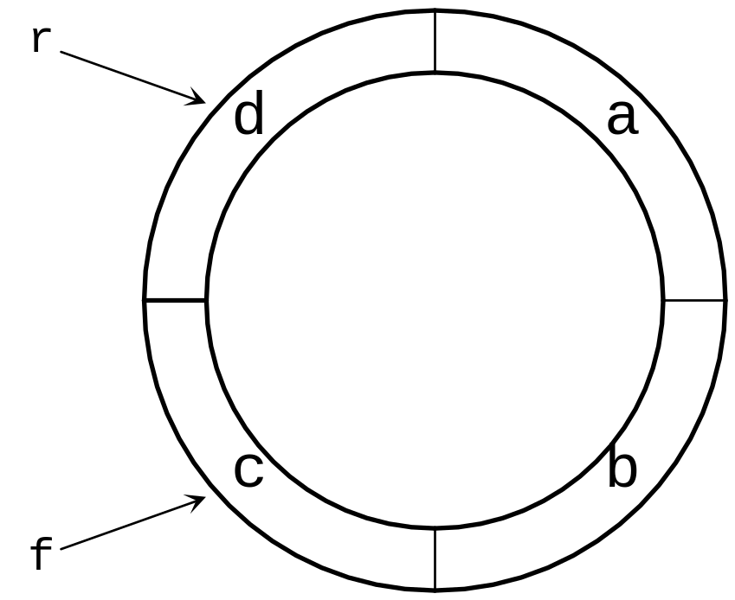
Figure 9-4: A Circular Queue
26年 11月 8日
Copyright © 1997 Oxford University Press
All Rights Reserved

Slide 9
Figure 9-5: Queue implementation in which full and empty queues cannot be distinguished
r
f
f
f
r
f
r
a
a
d
a
c
b
c
b
r
26年 11月 8日
Copyright © 1997 Oxford University Press
All Rights Reserved

Slide 10
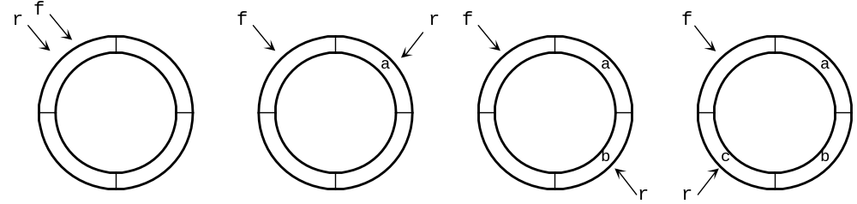
Figure 9-6: Corrected queue implementation demonstrated
26年 11月 8日
Copyright © 1997 Oxford University Press
All Rights Reserved

Slide 11
Code Example 9-2
// cx9-2.h
// Code Example 9-2: Header File for Queue
#ifndef __MB_CX9_2__
#define __MB_CX9_2__
#include "dslib.h"
const int maxQueue = 200;
template < class queueElementType >
class Queue {
26年 11月 8日
Copyright © 1997 Oxford University Press
All Rights Reserved

Slide 12
Code Example 9-2
public:
Queue();
void enqueue(queueElementType e);
queueElementType dequeue();
queueElementType front();
bool isEmpty();
private:
int f; // marks the front of the queue
int r; // marks the rear of the queue
queueElementType elements[maxQueue];
};
#endif
26年 11月 8日
Copyright © 1997 Oxford University Press
All Rights Reserved

Slide 13
Code Example 9-3(Circular queue)
// cx9-3.cpp
// Code Example 9-3: Implementation of a Circular Queue
#include "cx9-2.h"
int nextPos(int p)
{
if (p == maxQueue - 1) // at end of circle
return 0;
else
return p+1;
}
26年 11月 8日
Copyright © 1997 Oxford University Press
All Rights Reserved

Slide 14
Code Example 9-3
template < class queueElementType >
Queue < queueElementType >::Queue()
{
// start both front and rear at 0
f = 0;
r = 0;
}
template < class queueElementType >
void
Queue < queueElementType >::enqueue(queueElementType e)
{
26年 11月 8日
Copyright © 1997 Oxford University Press
All Rights Reserved

Slide 15
Code Example 9-3
// add e to the rear of the queue, advancing r to next position
assert(nextPos(r) != f);
r = nextPos(r);
elements[r] = e;
}
template < class queueElementType >
queueElementType
Queue < queueElementType >::dequeue()
{
// advance front of queue, return value of element at the front
assert(f != r);
f = nextPos(f);
return elements[f];
}
26年 11月 8日
Copyright © 1997 Oxford University Press
All Rights Reserved

Slide 16
Code Example 9-3
template < class queueElementType >
queueElementType
Queue < queueElementType >::front()
{
// return value of element at the front
assert(f != r);
return elements[nextPos(f)];
}
template < class queueElementType >
bool
Queue < queueElementType >::isEmpty()
{
// return true if the queue is empty, that is,
// if front is the same as rear
return bool(f == r);
}
26年 11月 8日
Copyright © 1997 Oxford University Press
All Rights Reserved

Slide 17
실습예제
Circular queue를 구현해보자
  프로젝트를 만든다.
  Class Queue를 생성하고 template이므로 *.h 에 넣고 *.cpp는 지운다. 물론 ~Queue도 넣음
  Main 함수 에 “queue.h” 를 포함하고, char queue 객체를 한 개 만들어서 ‘a’, ‘b’ 를 넣고 loop 에서 queue 가 빌때까지 빼면서 출력한다
  본문의 코드는 한 개 공간을 사용하지 않음으로 비어있는 것과 찬것을 구분하는데, 사실 현재 들어간 개수를 검사하면 다 채울수 있다. m_nElement 를 사용해서 공간을 다 사용하면서 비어있는 것과 찬것을 구분하는 코드로 바꿔본다.
  isFull 이라는함수도 만들고 이를 enqueue에서 불러서 체크하는 것으로 바꾼다. 마찬가지로 isEmpty 를 dequeue에서 사용하고.
26年 11月 8日
Copyright © 1997 Oxford University Press
All Rights Reserved

Slide 18
Code Example 9-4(linked list)
// cx9-4.h
// Code Example 9-4: Header for Queue as Dynamic List
#ifndef __MB_CX9_4__
#define __MB_CX9_4__
#include "dslib.h"
template < class queueElementType >
class Queue {
public:
26年 11月 8日
Copyright © 1997 Oxford University Press
All Rights Reserved

Slide 19
Code Example 9-4
Queue();
void enqueue(queueElementType e);
queueElementType dequeue();
queueElementType front();
bool isEmpty();
private:
struct Node;
typedef Node * nodePtr;
struct Node {
queueElementType data;
nodePtr next;
};
nodePtr f;
nodePtr r;
};
#endif
26年 11月 8日
Copyright © 1997 Oxford University Press
All Rights Reserved

Slide 20
Code Example 9-5
// cx9-5.cpp
// Code Example 9-5: Implementation for Queue as Dynamic List
#include "cx9-4.h"
template < class queueElementType >
Queue < queueElementType >::Queue()
{
// set both front and rear to null pointers
f = 0;
r = 0;
}
26年 11月 8日
Copyright © 1997 Oxford University Press
All Rights Reserved

Slide 21
Code Example 9-5
template < class queueElementType >
void
Queue < queueElementType >::enqueue(queueElementType e)
{
// create a new node, insert it at the rear of the queue
nodePtr n(new Node);
assert(n);
n->next = 0;
n->data = e;
if (f != 0) { // existing queue is not empty
r->next = n; // add new element to end of list
r = n;
}
26年 11月 8日
Copyright © 1997 Oxford University Press
All Rights Reserved

Slide 22
Code Example 9-5
else {// adding first item in the queue
f = n; // so front, rear must be same node
r = n;
}
}
template < class queueElementType >
queueElementType
Queue < queueElementType >::dequeue()
{
assert(f); // make sure queue is not empty
nodePtr n(f);
queueElementType frontElement(f->data);
26年 11月 8日
Copyright © 1997 Oxford University Press
All Rights Reserved

Slide 23
Code Example 9-5
f = f->next;
delete n;
if (f == 0) // we're deleting last node
r = 0;
return frontElement;
}
template < class queueElementType >
queueElementType
Queue < queueElementType >::front()
{
assert(f);
return f->data;
}
26年 11月 8日
Copyright © 1997 Oxford University Press
All Rights Reserved

Slide 24
Code Example 9-5
template < class queueElementType >
bool
Queue < queueElementType >::isEmpty()
{
// true if the queue is empty -- when f is a null pointer
return bool(f == 0);
}
26年 11月 8日
Copyright © 1997 Oxford University Press
All Rights Reserved

Slide 25
실습예제
프로젝트는 앞서 만든것을 사용하되, Queue class 만을 변경하자.
  이전클래스 내용은 다 comment out 하고
  Linked list version을 넣는다
  소멸자를 만들고, 현재 까지 할당된 공간들을 모두 풀어준다
  Main 함수에서 class CMyClass 를 queue로 만들고 사용하자
26年 11月 8日
Copyright © 1997 Oxford University Press
All Rights Reserved

